Slide 1
Ch02-补充（语法其他内容） More about syntax rules
林奕/Lin Yi
西北工业大学计算机学院/School of Computer Science
ly_cs@nwpu.edu.cn
2022/03

Slide 2
目录/Content

Slide 3
Part 01-Chomsky文法分类/Chomsky Hierarchy
重要内容 / Important contents：
4 types of grammars / 4类文法
4 types of automaton / 4类自动机
BNF&/EBNF表示与前后文无关文法 / BNF & EBNF for Context free language (2 type grammar)
正规文法& 正规式 &有限自动机 & 词法分析
Regular Grammar & Regular Expression / Finite Automata / Lexical Analysis

Slide 4
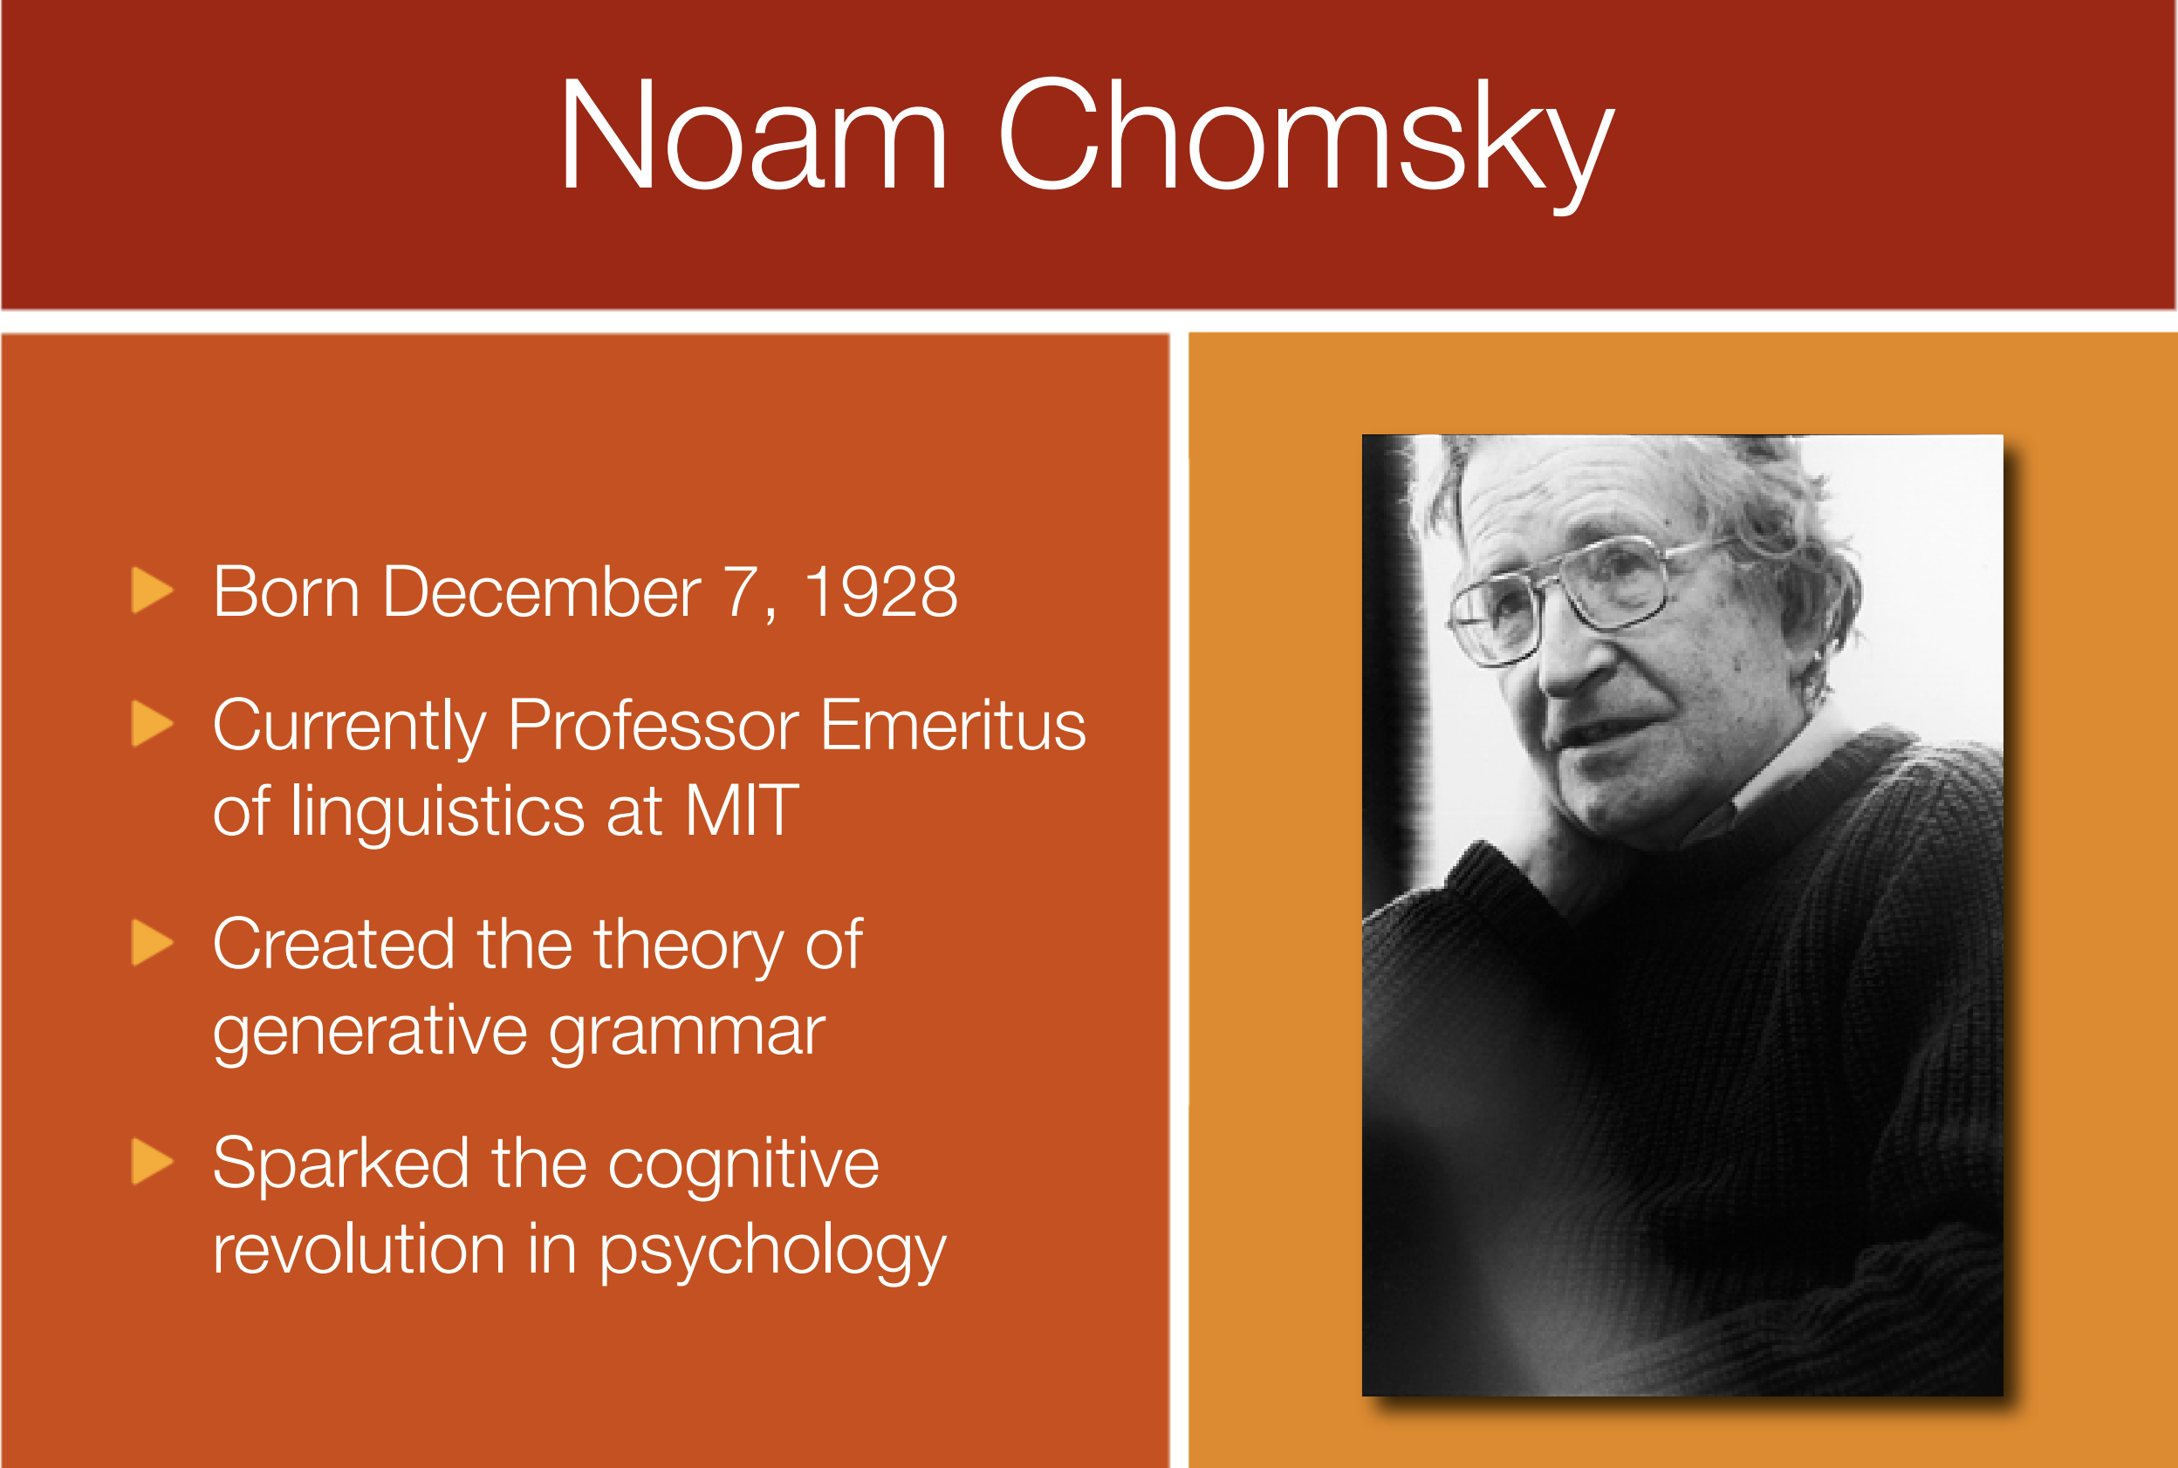
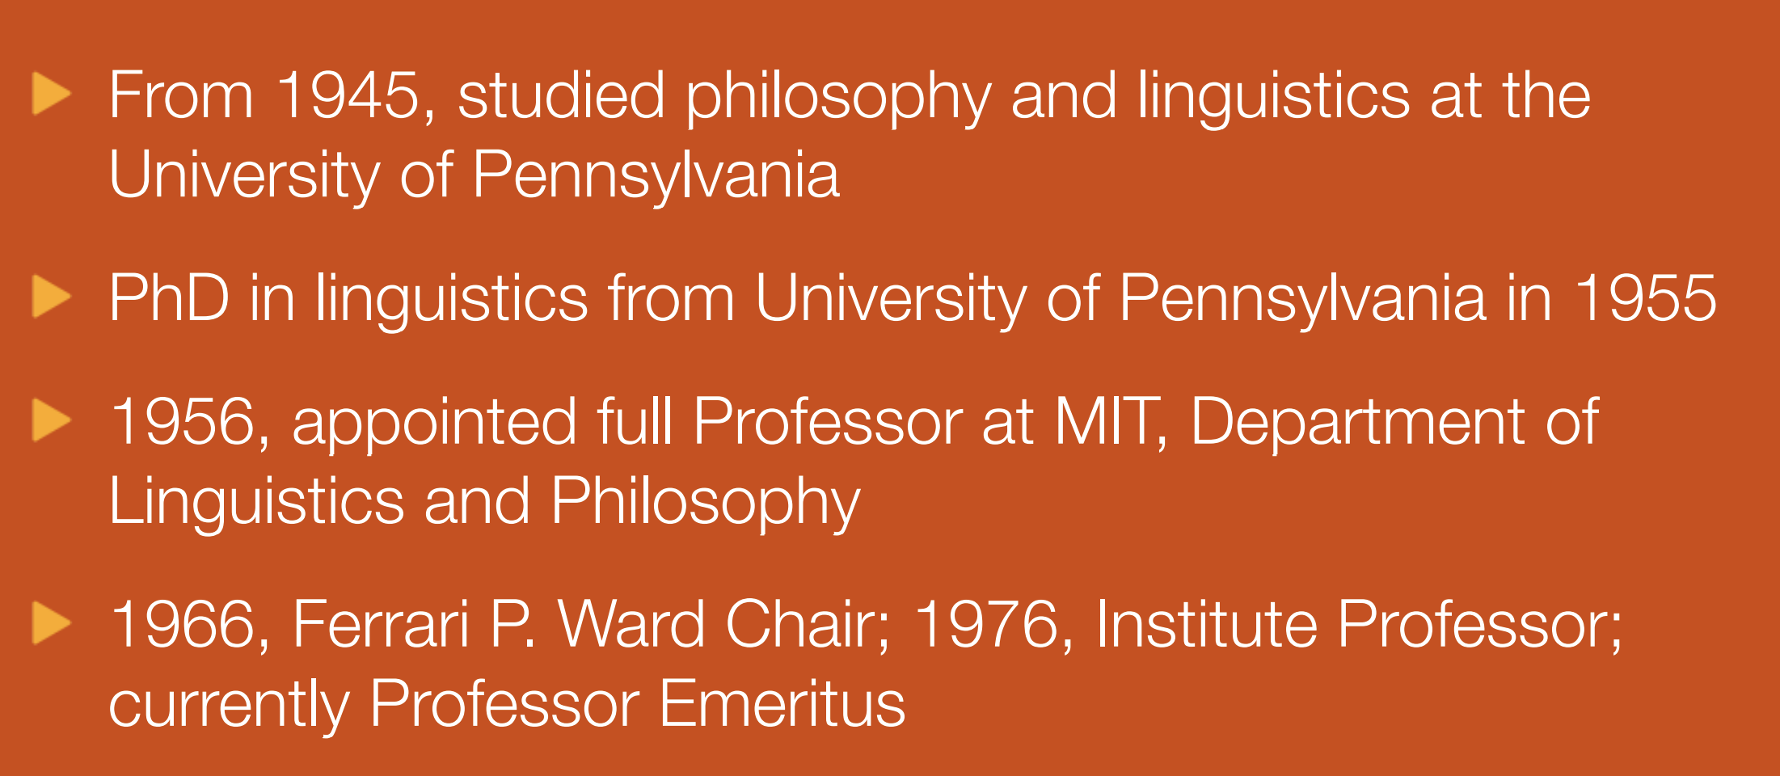
第一部分：形式语言简介 Part 01 : Intro to Formal Language
https://athena.ecs.csus.edu/~gordonvs/135/resources/ChomskyPresentation.pdf

Slide 5





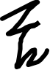





























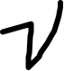










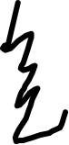






















语言 & 文法 / Language & Grammar
语言：语言是一组再预先符号集上可构造得到的有限长度语句的集合。
Language：“A language is a collection of sentences of finite length all constructed from a finite alphabet of symbols.”
文法：文法可以被认为是能够枚举出一个语言全部语句的装置。
Grammar: “A grammar can be regarded as a device that enumerates the sentences of a language.”
https://athena.ecs.csus.edu/~gordonvs/135/resources/ChomskyPresentation.pdf

Slide 6
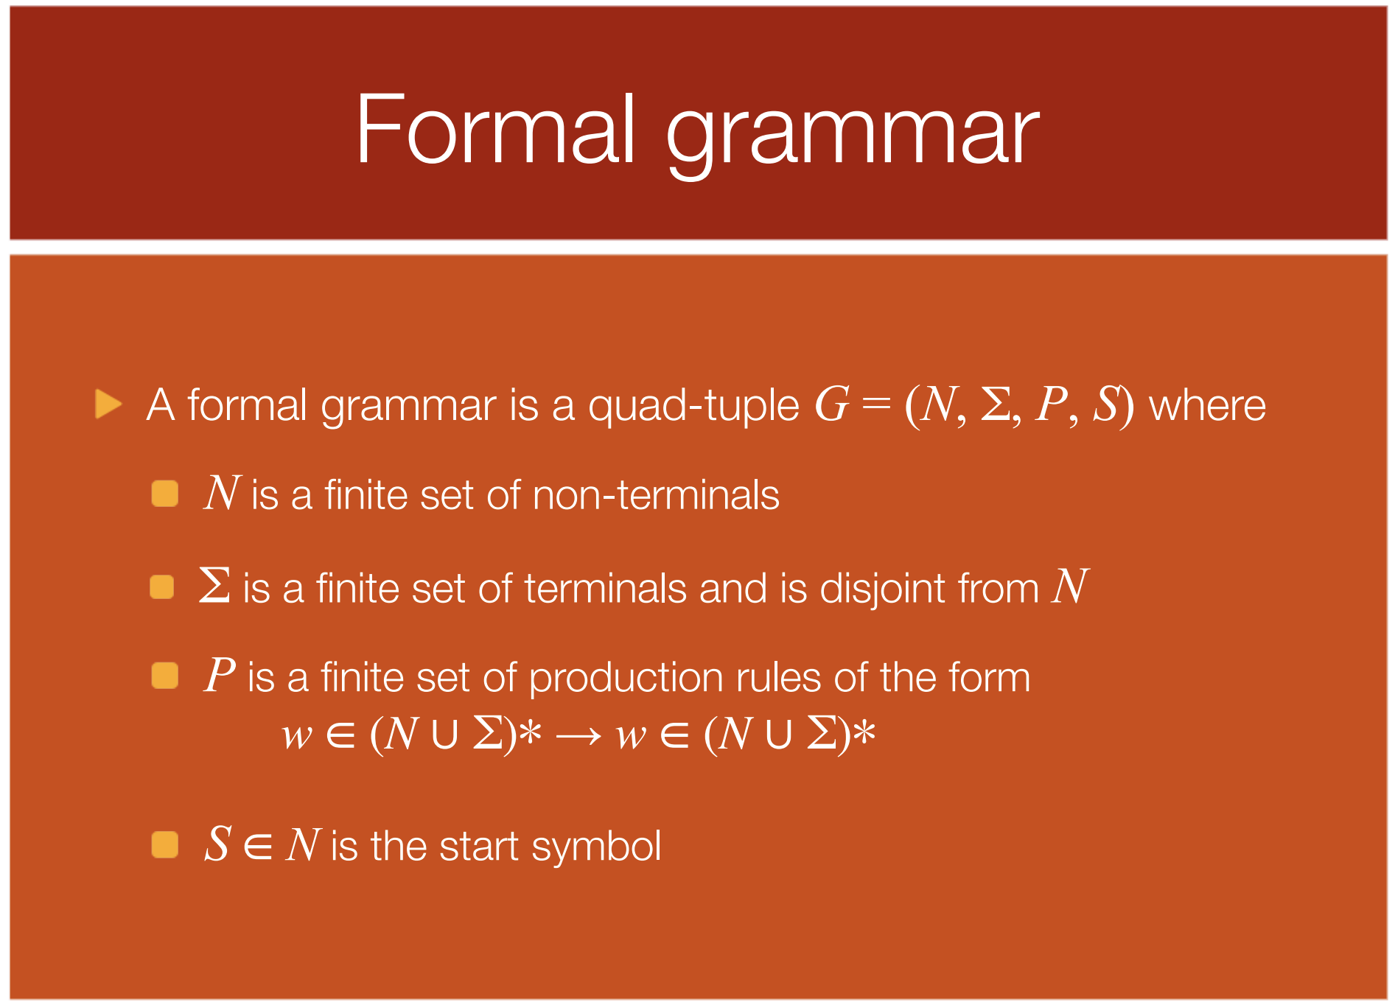





形式文法 / Formal Grammar
https://athena.ecs.csus.edu/~gordonvs/135/resources/ChomskyPresentation.pdf
形式文法可定义为一个四元组G=(N,∑,P,S)：
N是非终结符的有限集合
∑是终结符的有限集合（与N交集为空）
P是包含以下形式的产生式规则的有限集合 ：
w∈(N∪∑)*→w∈(N∪∑)*
S∈N是开始符

Slide 7
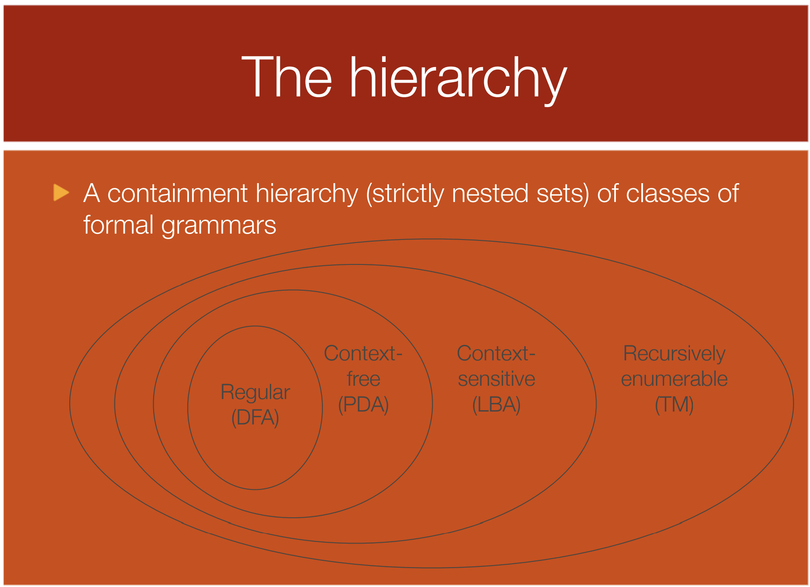















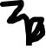


Chomsky分类/Chomsky Hierarchy
Regular language（正则语言）
DFA：
确定的有限自动机
Deterministic Finite Automata
Context-free language（前后文无关文法）
PDA：
下推自动机
Push down automata
Context-sensitive language（前后文相关文法）
LBA：线性有界自动机
Linear bounded automata
Recursively enumerable language（递归可枚举语言）
TM：
图灵机
Turing Machine
https://athena.ecs.csus.edu/~gordonvs/135/resources/ChomskyPresentation.pdf

Slide 8
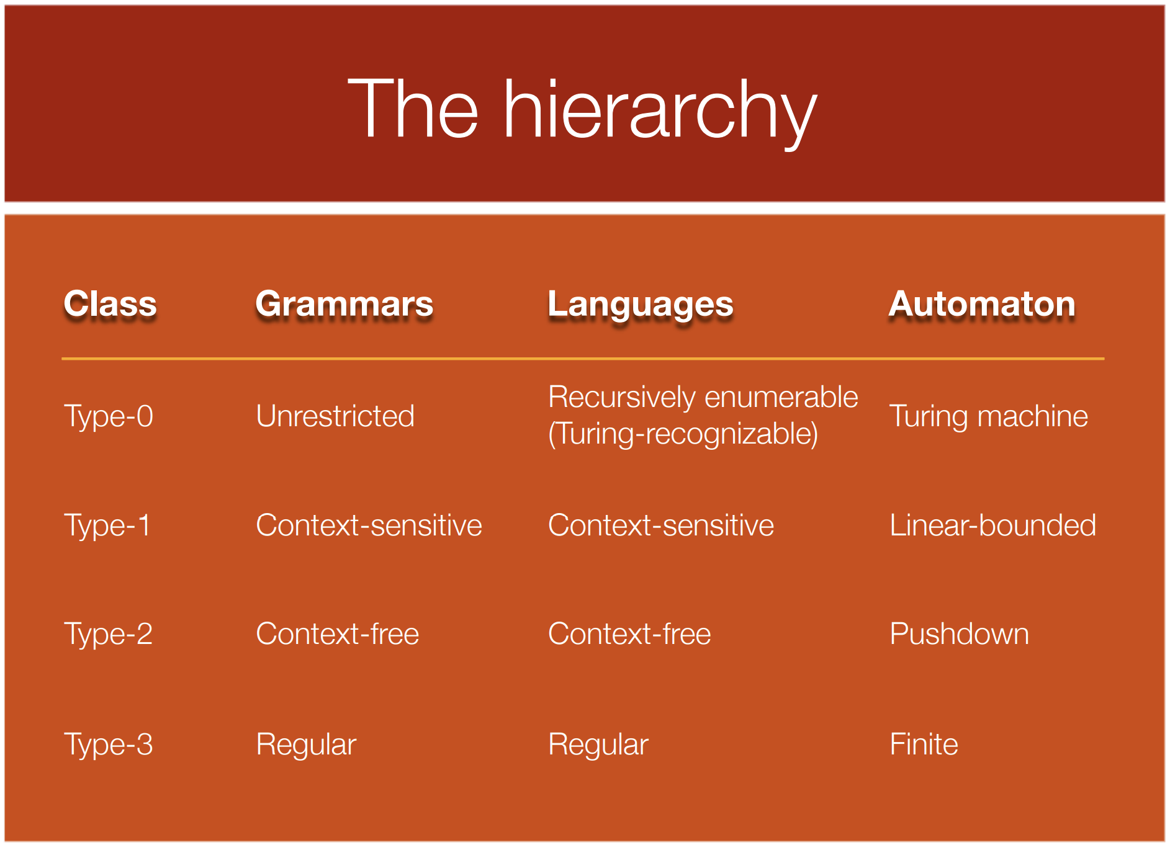



























Chomsky分类/Chomsky Hierarchy
https://athena.ecs.csus.edu/~gordonvs/135/resources/ChomskyPresentation.pdf

Slide 9
Type 0 & Turing Machine 0型文法 & 图灵机
https://athena.ecs.csus.edu/~gordonvs/135/resources/ChomskyPresentation.pdf

Slide 10
Type 1 Grammar / 1型文法
https://athena.ecs.csus.edu/~gordonvs/135/resources/ChomskyPresentation.pdf

Slide 11
Type 2 Grammar（Context free grammar / BNF ） 2型文法（前后文无关文法 / BNF表示 ）
BNF & EBNF
http://www.cs.man.ac.uk/~pjj/bnf/bnf.html
=> C program BNF & EBNF
http://www.cs.man.ac.uk/~pjj/bnf/c_syntax.bnf
http://www.cs.man.ac.uk/~pjj/bnf/c_syntax.k_r

Slide 12
Type 3 Grammar（Regular grammar/Linear grammar） 2型文法（正规文法/线性文法）

Slide 13
Part02-Grammar definition
02-0、Three different definitions of expression grammar / 表达式的三种文法
02-1、Left-associativie & right-associative grammar 、文法的左结合与右结合
02-2、文法等价性 / Equivalence of grammars
02-3、Priority of operator in grammar/ 文法中的运算优先级
02-4、Left Recursion of grammar & elimination / 文法的左递归及其消除方法
02-5、Left factor of grammar & elimination / 文法的左因子及其消除方法
02-6、Ambiguous grammar& language ambiguity / 文法二义性 & 语言的二义性

Slide 14
02-0、表达式文法的三种定义形式 three different definitions of expression grammar （龙书第二版 / dragon book 2nd：pp.122）
G₁[E]
E→E+T | T
T→T*F | F
F→(E) | id
suitable for LR analysis
适用于LR分析算法
G₂[E]
E→TE’
E’→+TE’ | ℇ
T→FT’
T’→*FT’ | ℇ
F→( E ) | id
without left recursion & suitable for top-down analysis
无左递归，适合自顶向上分析
G₃[E]
E→E+E | E*E
| ( E ) | id
有二义性
ambiguous grammar

Slide 15
02-1(1)左结合 & 右结合 / left- & right-associative
【G(right)】
right→letter = right | letter
letter→a | b | c
左结合文法 / left-associative grammar
右结合文法 /right-associative grammar
【G(list)】
(1)list→list - digit
(2) | digit
(3)digit→2
(4) | 5
(6) | 9

Slide 16
02-1(2-1)左结合 & 右结合 / left- & right-associative
左结合文法 / left-associative grammar
右结合文法 /right-associative grammar
【G(list)】
(1)list→list - digit
(2) | digit
(3)digit→2
(4) | 5
(6) | 9

Slide 17


















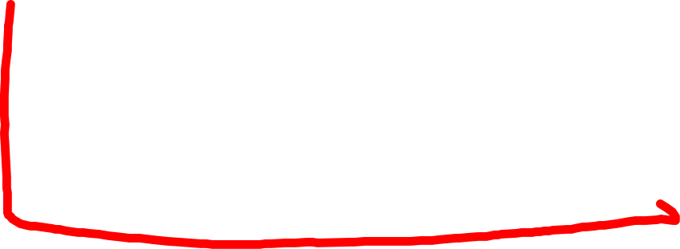




























































































02-1(2-2)左结合 & 右结合 / left- & right-associative
【G(list’)】
(1)list’→digit - list’
(2) | digit
(3)digit→2
(4) | 5
(6) | 9
左结合文法 / left-associative grammar
右结合文法 /right-associative grammar

Slide 18
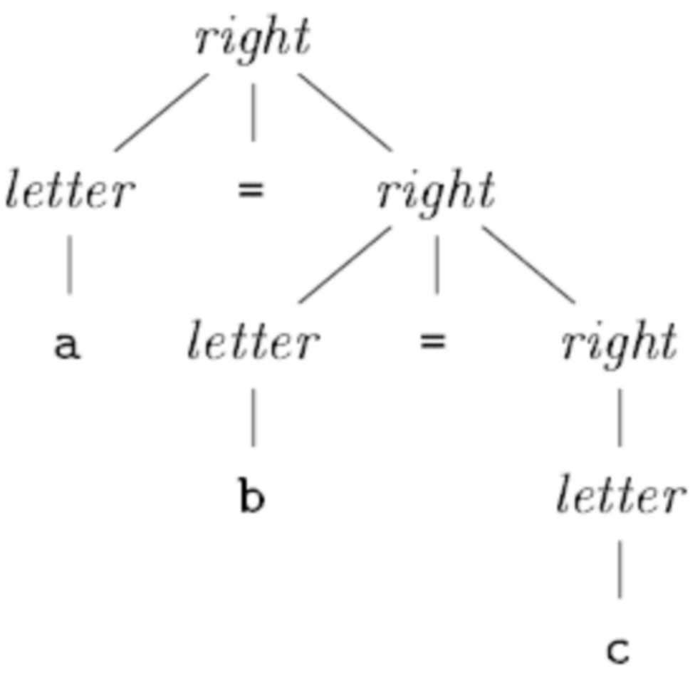


















































02-1(3)左结合 & 右结合 / left- & right-associative
【G(right)】
right→letter = right | letter
letter→a | b | c
左结合文法 / left-associative grammar
右结合文法 /right-associative grammar

Slide 19
























































【G(listR)】
(1)listR→digit - listR
(2) | digit
(3)digit→2
(4) | 5
(6) | 9
【G(list)】
(1)list→list - digit
(2) | digit
(3)digit→2
(4) | 5
(6) | 9

Slide 20












































02-1(3)左结合 & 右结合 / left- & right-associative
【G(left)】
left→left = CH | CH
CH→a | b | c
左结合文法 / left-associative grammar
右结合文法 /right-associative grammar
函数调用 / function call：
f(a, b, c)
函数调用 / function call：
int x=0;
int g1() { x=x+1; return x; }
int g2() { x=x+2; return x; }
int g3() { x=x+3; return x; }
f(g1(),g2(),g3());
左结合/left-associative：
实参压栈顺序
order to push args into stack
(1) push c
(2) push b
(3) push a
(4) call f
右结合/right-associative
(1) push a
(2) push b
(3) push c
(4) call f
左结合/left-associative：
实参压栈顺序
order to push args into stack
t1=g1();
t2=g2();
t3=g3();
f(t1, t2, t3) // f(1, 3, 6)
右结合/right-associative：
实参压栈顺序
order to push args into stack
t1=g3();
t2=g2();
t3=g1();
f( t3, t2, t1) //f(6, 3, 1)

Slide 21
02-2 文法等价性 / Equivalence of grammars

Slide 22

































































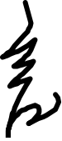
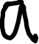






















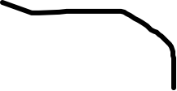



















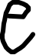


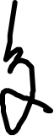






02-2(1)文法等价性 / Equivalence of grammars
什么是语言的定义？
What is language (definition)?
G(left)和G(right)是否等价？
Do G(left) and G(right) ? represent the same language?
【G(left)】
left→left = CH | CH
CH→a | b | c
【G(right)】
right→letter = right | letter
letter→a | b | c

Slide 23
02-3 运算符的优先级 / Priorities of operators
结合性是对相同优先级运算符而言的
( associative is properties of operators with different priorities )
对不同优先级的运算符，需要其他方法处理
( operators with different priorities should be dealed with other approaches )

Slide 24













































02-3 运算符的优先级 / Priorities of operators （1）例子 / Example
E→E+T | T
T→T*F | F
F→id
id→’a’ | ‘b’ | ‘c’
输入程序/input program
a + b * c
E→E*T | T
T→T+F | F
F→id
id→’a’ | ‘b’ | ‘c’

Slide 25






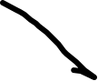































02-3 运算符的优先级 / Priorities of operators （1）例子 / Example
E→E+T | T
T→T*F | F
F→id
id→’a’ | ‘b’ | ‘c’
输入程序/input program
a + b * c
E→E*T | T
T→T+F | F
F→id
id→’a’ | ‘b’ | ‘c’

Slide 26



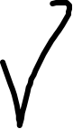



02-3 运算符的优先级 / Priorities of operators （2）语法分析与运算符优先级/Syntax analysis & priorities
E→E+T | T
T→T*F | F
F→id
id→’a’ | ‘b’ | ‘c’
即使文法包含了优先级，也不代表语法分析器能够很好处理优先级。
Although grammar is defined with priority constraints, this does not means that syntax analysis algorithm could deal with priorities of operators easily.
相关内容见语法分析部分的内容 / See syntax analysis parts of this course.
E→E+E | E*E | id
id→’a’ | ‘b’ | ‘c’
二义性文法也可以处理优先级。
Ambiguous grammar could deal with operators’ priorities too.

Slide 27
02-4 左递归/Left-recursive grammar
龙书“2.4.5节”，pp.42 / Dragon book: section 2.4.5

Slide 28












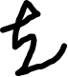
























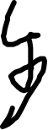
































02-4 左递归/Left-recursive grammar (1) 什么是直接左递归文法/what is direct recursive grammar
文法中的左递归（直接左递归）
Left recursion of grammar ( direct left recursion )
E→E+T | T
T→T*F | F
F→id
id→’a’ | ‘b’ | ‘c’

Slide 29
























































02-4 左递归/Left-recursive grammar (2-1) 改造直接左递归文法/modify direct recursive grammar
文法中的左递归（直接左递归）
Left recursion of grammar ( direct left recursion )
消除直接左递归 / Eliminate direct left recursion
观察 & 改造/Observe & modify：
E→E+T | T
(1)E=>T
(2)E=>E+T=>T+T
(3)E=>E+T=>E+T+T=>T+T+T
E→T +T+T...+T
改造文法/modified grammar：
E→TE’
E’→+TE’ | ℇ
E’=>ℇ | +T | +T+T | +T+T...+T
E→E+T | T
T→T*F | F
F→id
id→’a’ | ‘b’ | ‘c’
E→TE’
E’→+TE’ | ℇ
T→FT’
T’→*FT’ | ℇ
F→id
id→’a’ | ‘b’ | ‘c’

Slide 30
02-4 左递归/Left-recursive grammar (2-2) 改造直接左递归文法/modify direct recursive grammar
文法中的左递归（直接左递归）
Left recursion of grammar ( direct left recursion )
消除直接左递归 / Eliminate direct left recursion
观察 & 改造/Observe & modify：
E→E+T | T
T→T*F | F
F→id
id→’a’ | ‘b’ | ‘c’
左结合特性是否被破坏了？
Is the grammar still left-associative?
a+b+c
E→TE’
E’→+TE’ | ℇ
T→FT’
T’→*FT’ | ℇ
F→id
id→’a’ | ‘b’ | ‘c’

Slide 31













































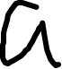









左结合特性是否被破坏了？
Is the grammar still left-associative?
a+b+c
E→E+T | T
T→T*F | F
F→id
id→’a’ | ‘b’ | ‘c’

Slide 32




































左结合特性是否被破坏了？
Is the grammar still left-associative?
a+b+c //左结合 - left-associative
a+b*c+d //左结合&优先级 - left-assoc& priority
f(E,E,E) //右结合 - right-associative
E=>TE’=>FT’E’=>idT’E’=>’a’ T’E’
=>’a’ E’=>’a’ +TE’=>’a’ + FT’E’
=>’a’ + idT’E’=>’a’ + ‘b’ T’ E’
=>’a’ + ‘b’ E’
=>’a’ + ‘b’ + TE’
=>’a’ + ‘b’ + FT’E’
=>’a’ + ‘b’ + idT’E’
=>’a’ + ‘b’ + ‘c’ T’E’
=>’a’ + ‘b’ + ‘c’ E’
=>’a’ + ‘b’ + ‘c’
E→TE’
E’→+TE’ | ℇ
T→FT’
T’→*FT’ | ℇ
F→id
id→’a’ | ‘b’ | ‘c’

Slide 33
















左结合特性是否被破坏了？
Is the grammar still left-associative?
a+b+c //左结合 - left-associative
a+b*c+d //左结合&优先级 - left-assoc& priority
f(E,E,E) //右结合 - right-associative
E=>TE’=>FT’E’=>idT’E’=>’a’ T’E’
=>’a’ E’=>’a’ +TE’=>’a’ + FT’E’
=>’a’ + idT’E’=>’a’ + ‘b’ T’ E’
=>’a’ + ‘b’ E’
=>’a’ + ‘b’ + TE’
=>’a’ + ‘b’ + FT’E’
=>’a’ + ‘b’ + idT’E’
=>’a’ + ‘b’ + ‘c’ T’E’
=>’a’ + ‘b’ + ‘c’ E’
=>’a’ + ‘b’ + ‘c’
E→TE’
E’→+TE’ | ℇ
T→FT’
T’→*FT’ | ℇ
F→id
id→’a’ | ‘b’ | ‘c’

Slide 34





























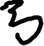


























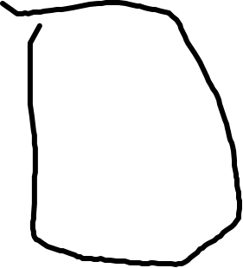












左结合特性是否被破坏了？
Is the grammar still left-associative?
a+b+c //左结合 - left-associative
a+b*c+d //左结合&优先级 - left-assoc& priority
f(E,E,E) //右结合 - right-associative
E=>TE’=>FT’E’=>idT’E’=>’a’ T’E’
=>’a’ E’=>’a’ +TE’=>’a’ + FT’E’
=>’a’ + idT’E’=>’a’ + ‘b’ T’ E’
=>’a’ + ‘b’ E’
=>’a’ + ‘b’ + TE’
=>’a’ + ‘b’ + FT’E’
=>’a’ + ‘b’ + idT’E’
=>’a’ + ‘b’ + ‘c’ T’E’
=>’a’ + ‘b’ + ‘c’ E’
=>’a’ + ‘b’ + ‘c’
E→TE’
E’→+TE’ | ℇ
T→FT’
T’→*FT’ | ℇ
F→id
id→’a’ | ‘b’ | ‘c’

Slide 35




















































左结合特性是否被破坏了？
Is the grammar still left-associative?
a+b+c //左结合 - left-associative
a+b*c+d //左结合&优先级 - left-assoc& priority
f(E,E,E) //右结合 - right-associative
E=>TE’=>FT’E’=>idT’E’=>’a’ T’E’
=>’a’ E’=>’a’ +TE’=>’a’ + FT’E’
=>’a’ + idT’E’=>’a’ + ‘b’ T’ E’
=>’a’ + ‘b’ E’
=>’a’ + ‘b’ + TE’
=>’a’ + ‘b’ + FT’E’
=>’a’ + ‘b’ + idT’E’
=>’a’ + ‘b’ + ‘c’ T’E’
=>’a’ + ‘b’ + ‘c’ E’
=>’a’ + ‘b’ + ‘c’
E→TE’
E’→+TE’ | ℇ
T→FT’
T’→*FT’ | ℇ
F→id
id→’a’ | ‘b’ | ‘c’

Slide 36






































左结合特性是否被破坏了？
Is the grammar still left-associative?
a+b+c //左结合 - left-associative
a+b*c+d //左结合&优先级 - left-assoc& priority
f(E,E,E) //右结合 - right-associative
E=>TE’=>FT’E’=>idT’E’=>’a’ T’E’
=>’a’ E’=>’a’ +TE’=>’a’ + FT’E’
=>’a’ + idT’E’=>’a’ + ‘b’ T’ E’
=>’a’ + ‘b’ E’
=>’a’ + ‘b’ + TE’
=>’a’ + ‘b’ + FT’E’
=>’a’ + ‘b’ + idT’E’
=>’a’ + ‘b’ + ‘c’ T’E’
=>’a’ + ‘b’ + ‘c’ E’
=>’a’ + ‘b’ + ‘c’
E→TE’
E’→+TE’ | ℇ
T→FT’
T’→*FT’ | ℇ
F→id
id→’a’ | ‘b’ | ‘c’

Slide 37













E→TE’
E’→+TE’ | ℇ
T→FT’
T’→*FT’ | ℇ
F→id
id→’a’ | ‘b’ | ‘c’
E→TE’
E’→+TE’ | ℇ
T→FT’
T’→*FT’ | ℇ
F→id
id→’a’ | ‘b’ | ‘c’

Slide 38
E→TE’
E’→+TE’ | ℇ
T→FT’
T’→*FT’ | ℇ
F→id
id→’a’ | ‘b’ | ‘c’
E→TE’
E’→+TE’ | ℇ
T→FT’
T’→*FT’ | ℇ
F→id
id→’a’ | ‘b’ | ‘c’

Slide 39
E→TE’
E’→+TE’ | ℇ
T→FT’
T’→*FT’ | ℇ
F→id
id→’a’ | ‘b’ | ‘c’
E→TE’
E’→+TE’ | ℇ
T→FT’
T’→*FT’ | ℇ
F→id
id→’a’ | ‘b’ | ‘c’

Slide 40
E→TE’
E’→+TE’ | ℇ
T→FT’
T’→*FT’ | ℇ
F→id
id→’a’ | ‘b’ | ‘c’
E→TE’
E’→+TE’ | ℇ
T→FT’
T’→*FT’ | ℇ
F→id
id→’a’ | ‘b’ | ‘c’

Slide 41
E→TE’
E’→+TE’ | ℇ
T→FT’
T’→*FT’ | ℇ
F→id
id→’a’ | ‘b’ | ‘c’
E→TE’
E’→+TE’ | ℇ
T→FT’
T’→*FT’ | ℇ
F→id
id→’a’ | ‘b’ | ‘c’
如果我们希望得到右结合的AST呢？
if right associative AST ?

Slide 42
E→TE’
E’→+TE’ | ℇ
T→FT’
T’→*FT’ | ℇ
F→id
id→’a’ | ‘b’ | ‘c’
如果我们希望得到右结合的AST呢？
if right associative AST ?

Slide 43
E→TE’
E’→+TE’ | ℇ
T→FT’
T’→*FT’ | ℇ
F→id
id→’a’ | ‘b’ | ‘c’
如果我们希望得到右结合的AST呢？
if right associative AST ?

Slide 44
E→TE’
E’→+TE’ | ℇ
T→FT’
T’→*FT’ | ℇ
F→id
id→’a’ | ‘b’ | ‘c’
如果我们希望得到右结合的AST呢？
if right associative AST ?

Slide 45
02-4 左递归/Left-recursive grammar (3) EBNF改造直接左递归文法 modify direct recursive grammar with EBNF
文法中的左递归（直接左递归）
Left recursion of grammar ( direct left recursion )
消除直接左递归 / Eliminate direct left recursion
观察 & 改造/Observe & modify：
E→E+T | T
(1)E=>T
(2)E=>E+T=>T+T
(3)E=>E+T=>E+T+T=>T+T+T
E→T +T+T...+T
改造文法/modified grammar：
E→T { +T }
E’=>ℇ | +T | +T+T | +T+T...+T
E→E+T | T
T→T*F | F
F→id
id→’a’ | ‘b’ | ‘c’
E→T { +T }
T→F {*F}
F→id
id→’a’|’b’|’c’

Slide 46
02-4 左递归/Left-recursive grammar (4) 4种无直接左递归文法对比 / Compare 4 grammars with or without left recursion
间接左递归）
Indirect left recursion of grammar
消除直接左递归 / Eliminate direct left recursion
观察 & 改造/Observe & modify：
E→E+T | T
T→T*F | F
F→id
id→’a’ | ‘b’ | ‘c’
E→T+E | T
T→F*T | F
F→id
id→’a’ | ‘b’ | ‘c’
E→TE’
E’→+TE’ | ℇ
T→FT’
T’→*FT’ | ℇ
F→id
id→’a’ | ‘b’ | ‘c’
EBNF：
E→T { +T }
T→F {*F}
F→id
id→’a’|’b’|’c’

Slide 47
递归下降/Recursive descent analysis
E→E+T | T
T→T*F | F
F→id
id→’a’ | ‘b’ | ‘c’
char input=”a+b*c”;
int E(){
if (E()==TRUE)
if(match(‘+’)
if(T()==TRUE)
return TRUE;
else if(T()==TRUE)
return TRUE;
return FALSE;
}
char input=”a+b*c”;
int idx=0;
int E(){
if (E()==TRUE)
if(match(‘+’)
if(T()==TRUE)
return TRUE;
else if(T()==TRUE)
return TRUE;
return FALSE;
}
char input=”a+b*c”;
int idx=0;
int E(){
if (E()==TRUE)
if(input[idx++]==’+’)
if(T()==TRUE)
return TRUE;
else if(T()==TRUE)
return TRUE;
return FALSE;
}
int F(){
if (id()!=0)
return TRUE;
return FALSE;
}
int F(){
if (id()!=0)
return TRUE;
return FALSE;
}
int id() {
char ch=input[idx];
idx++;
switch(ch){
case ‘a’: return ‘a’;
case ‘b’: return ‘b’;
case ‘c’: return ‘c’;
default: return 0;
}
return 0;
}
int T(){
if (T()==TRUE)
if(input[idx++]==’*’)
if(F()==TRUE)
return TRUE;
else if(F()==TRUE)
return TRUE;
return FALSE;
}

Slide 48
递归下降/Recursive descent analysis
E→E+T | T
T→T*F | F
F→id
id→’a’ | ‘b’ | ‘c’
char input=”a+b*c”;
int E(){
if (E()==TRUE)
if(match(‘+’)
if(T()==TRUE)
return TRUE;
else if(T()==TRUE)
return TRUE;
return FALSE;
}
char input=”a+b*c”;
int idx=0;
int E(){
if (E()==TRUE)
if(match(‘+’)
if(T()==TRUE)
return TRUE;
else if(T()==TRUE)
return TRUE;
return FALSE;
}
char input=”a+b*c”;
int idx=0;
int E(){
if (E()==TRUE)
if(input[idx++]==’+’)
if(T()==TRUE)
return TRUE;
else if(T()==TRUE)
return TRUE;
return FALSE;
}

Slide 49
递归下降/Recursive descent analysis
E→E+T | T
T→T*F | F
F→id
id→’a’ | ‘b’ | ‘c’
char input=”a+b*c”;
int E(){
if (E()==TRUE)
if(match(‘+’)
if(T()==TRUE)
return TRUE;
else if(T()==TRUE)
return TRUE;
return FALSE;
}
char input=”a+b*c”;
int idx=0;
int E(){
if (E()==TRUE)
if(match(‘+’)
if(T()==TRUE)
return TRUE;
else if(T()==TRUE)
return TRUE;
return FALSE;
}
char input=”a+b*c”;
int idx=0;
int E(){
if (E()==TRUE)
if(input[idx++]==’+’)
if(T()==TRUE)
return TRUE;
else if(T()==TRUE)
return TRUE;
return FALSE;
}
int T(){
if (T()==TRUE)
if(input[idx++]==’*’)
if(F()==TRUE)
return TRUE;
else if(F()==TRUE)
return TRUE;
return FALSE;
}

Slide 50
递归下降/Recursive descent analysis
E→E+T | T
T→T*F | F
F→id
id→’a’ | ‘b’ | ‘c’
char input=”a+b*c”;
int E(){
if (E()==TRUE)
if(match(‘+’)
if(T()==TRUE)
return TRUE;
else if(T()==TRUE)
return TRUE;
return FALSE;
}
char input=”a+b*c”;
int idx=0;
int E(){
if (E()==TRUE)
if(match(‘+’)
if(T()==TRUE)
return TRUE;
else if(T()==TRUE)
return TRUE;
return FALSE;
}
char input=”a+b*c”;
int idx=0;
int E(){
if (E()==TRUE)
if(input[idx++]==’+’)
if(T()==TRUE)
return TRUE;
else if(T()==TRUE)
return TRUE;
return FALSE;
}
int F(){
if (id()!=0)
return TRUE;
return FALSE;
}
int T(){
if (T()==TRUE)
if(input[idx++]==’*’)
if(F()==TRUE)
return TRUE;
else if(F()==TRUE)
return TRUE;
return FALSE;
}

Slide 51
递归下降/Recursive descent analysis
E→E+T | T
T→T*F | F
F→id
id→’a’ | ‘b’ | ‘c’
char input=”a+b*c”;
int E(){
if (E()==TRUE)
if(match(‘+’)
if(T()==TRUE)
return TRUE;
else if(T()==TRUE)
return TRUE;
return FALSE;
}
char input=”a+b*c”;
int idx=0;
int E(){
if (E()==TRUE)
if(match(‘+’)
if(T()==TRUE)
return TRUE;
else if(T()==TRUE)
return TRUE;
return FALSE;
}
char input=”a+b*c”;
int idx=0;
int E(){
if (E()==TRUE)
if(input[idx++]==’+’)
if(T()==TRUE)
return TRUE;
else if(T()==TRUE)
return TRUE;
return FALSE;
}
int F(){
if (id()!=0)
return TRUE;
return FALSE;
}
int F(){
if (id()!=0)
return TRUE;
return FALSE;
}
int id() {
char ch=input[idx];
idx++;
switch(ch){
case ‘a’: return ‘a’;
case ‘b’: return ‘b’;
case ‘c’: return ‘c’;
default: return 0;
}
return 0;
}
int T(){
if (T()==TRUE)
if(input[idx++]==’*’)
if(F()==TRUE)
return TRUE;
else if(F()==TRUE)
return TRUE;
return FALSE;
}

Slide 52
ENBF递归下降/Recursive descent analysis (EBNF)
EBNF：
E→T { +T }
T→F {*F}
F→id
id→’a’|’b’|’c’
char input=”a+b*c”;
int idx=0;
int E(){
if (T()==TRUE)
while(input[idx++]==’+’)
if(T()==FALSE)
return FALSE;
else return FALSE;
return TRUE;
}
int F(){
if (id()!=0)
return TRUE;
return FALSE;
}
int F(){
if (id()!=0)
return TRUE;
return FALSE;
}
int id() {
char ch=input[idx];
idx++;
switch(ch){
case ‘a’: return ‘a’;
case ‘b’: return ‘b’;
case ‘c’: return ‘c’;
default: return 0;
}
return 0;
}
int T(){
if (F()==TRUE)
while(input[idx++]==’*’)
if(F()==FALSE)
return FALSE;
else return FALSE;
return TRUE;
}

Slide 53
E→TE’
E’→+TE’ | ℇ
T→FT’
T’→*FT’ | ℇ
F→id
id→’a’ | ‘b’ | ‘c’
E=>TE’=>FT’E’=>idT’E’=>’a’ T’E’
=>’a’ E’=>’a’ +TE’=>’a’ + FT’E’
=>’a’ + idT’E’=>’a’ + ‘b’ T’ E’
=>’a’ + ‘b’ E’
=>’a’ + ‘b’ + TE’
=>’a’ + ‘b’ + FT’E’
=>’a’ + ‘b’ + idT’E’
=>’a’ + ‘b’ + ‘c’ T’E’
=>’a’ + ‘b’ + ‘c’ E’
=>’a’ + ‘b’ + ‘c’
E→TE’
E’→+TE’ | ℇ
T→FT’
T’→*FT’ | ℇ
F→id
id→’a’ | ‘b’ | ‘c’
怎样在递归下降中生成抽象语法树
How to generate AST in recursive descent parsing？

Slide 54
02-4 左递归/Left-recursive grammar (5) 间接左递归 / indirect recursive grammar
间接左递归）
Indirect left recursion of grammar
间接左递归消除算法见龙书
elimination algorithm for indirect recursion could be found in the Dragon book.
A→aBc
B→bA | b

Slide 55
02-5 左因子/Left factor of grammar (1)左因子及问题/Left factor & trouble
E→E+T | T
T→T*F | F
F→id | id [ id ]
F→id | id [ id ]
int F(){
switch (lex()){
case id: return TRUE;
case id: if(lex()= ‘[‘)
if(lex()=id)
if(lex()=’]’)
return TRUE;
}
return FALSE;
}

Slide 56
02-5 左因子/Left factor of grammar (1)左因子及问题/Left factor & trouble
E→E+T | T
T→T*F | F
F→id | id [ id ]
F→id | id [ id ]
int F(){
switch (lex()){
case id: return TRUE;
case id: if(lex()= ‘[‘)
if(lex()=id)
if(lex()=’]’)
return TRUE;
}
return FALSE;
}
E→E+T | T
T→T*F | F
F→id A
A→[ id ] | ε

Slide 57
02-6 Ambiguous grammar / 二义性文法

Slide 58
02-6(1) Ambiguous grammar / 二义性文法
判定条件/condition to judge ambiguity of grammar
(1) 同一个文法，存在两个不同的最左推导序列（或仅用最右推导），得到相同的符号串
Given a grammar, there exists at least two different sequences of left-most derivation ( or only use right-most derivation) to generate the same string.
【G(string)】
string→string + string | string - string | num
num→0 | 1 | ... | 9
string => ...
=> 9 - 5 + 2

Slide 59
02-6(2) Ambiguous grammar / 二义性文法 （无严重后果的例子/Examples without serious error）
判定条件/condition to judge ambiguity of grammar
(2)同一个文法，对于同一个符号串，存在两个不同的具体语法树（分析树）
Given a grammar, there exists at least two different sequences of parsing trees to generate the same string.
【G(string)】
string→string + string | string - string | num
num→0 | 1 | ... | 9

Slide 60
02-6(3)Ambiguous grammar / 二义性文法 （优先级错误/Examples with priority error）
【G(E)】
E→E + E | E - E
| num
num→0 | 1 | ... | 9

Slide 61
02-6(4)Ambiguous grammar / 二义性文法
判定条件/condition to judge ambiguity of grammar
(3)若一个文法既有左递归，又有有递归。则该文法是二义性的（充分条件）
If a grammar definition has left-recursion & right-recursion at the same time, the grammar is ambiguous. This is the sufficient condition for ambiguous grammar).
【G(E)】
E→E + E | E - E
| num
num→0 | 1 | ... | 9

Slide 62
02-6(5-1)"if-else"的二义性/Ambiguity of "if-else"
龙书第4章4.3.1节
pp.133
if-else例子/example of if-else
【G(stmt)】
(1)S→if E then S
(2) | if E then St else S
(3) | other
(4)E→id<id
(5)other→id=id ;
说明/Notice：
**这里假定other只能是变量赋值语句
**suppose ‘other’ is assign statement

Slide 63
02-6(5-2)"if-else"的二义性/Ambiguity of "if-else"
龙书第4章4.3.1节
pp.133
if-else例子/example of if-else
【G(stmt)】程序/program
if a<b then a=b
else if x<y then a=x
else a=y
（无二义性的例子/without ambiguit)
【G(stmt)】
(1)S→if E then S
(2) | if E then St else S
(3) | other
(4)E→id<id
(5)other→id=id ;
说明/Notice：
**这里假定other只能是变量赋值语句
**suppose ‘other’ is assign statement

Slide 64
02-6(5-3)"if-else"的二义性/Ambiguity of "if-else"
龙书第4章4.3.1节
pp.133
if-else例子/example of if-else
【G(stmt)】程序/program
if a<b then if x<y then a=x; else a=y;
（二义性例子/ambiguit)
else悬挂问题 / dangling else problem
（1）if a<b then
if x<y then a=x; else a=y;
（2）if a<b then
if x < y then a=x;
else a=y;
【G(stmt)】
(1)S→if E then S
(2) | if E then St else S
(3) | other
(4)E→id<id
(5)other→id=id ;
说明/Notice：
**这里假定other只能是变量赋值语句
**suppose ‘other’ is assign statement

Slide 65
02-6(5-4)"if-else"的二义性/Ambiguity of "if-else"
【G(stmt)】程序/program
if a<b then if x<y then a=x; else a=y;
（二义性例子/ambiguit)
龙书第4章4.3.1节
pp.133
if-else例子/example of if-else
else悬挂问题 / dangling else problem
（1）if a<b then
if x<y then a=x; else a=y;
【G(stmt)】
(1)S→if E then S
(2) | if E then St else S
(3) | other
(4)E→id<id
(5)other→id=id ;
说明/Notice：
**这里假定other只能是变量赋值语句
**suppose ‘other’ is assign statement
S
if
E
then
S
id_{a}
<
id_{b}
if
E
then
S
else
S
id_{x}
<
id_{y}
a
=
i
;
a
=
x
;

Slide 66
02-6(5-5)"if-else"的二义性/Ambiguity of "if-else"
else悬挂问题 / dangling else problem
（2）if a<b then
if x < y then a=x;
else a=y;
【G(stmt)】程序/program
if a<b then if x<y then a=x; else a=y;
（二义性例子/ambiguit)
龙书第4章4.3.1节
pp.133
if-else例子/example of if-else
【G(stmt)】
(1)S→if E then S
(2) | if E then St else S
(3) | other
(4)E→id<id
(5)other→id=id ;
说明/Notice：
**这里假定other只能是变量赋值语句
**suppose ‘other’ is assign statement
S
if
E
then
S
else
S
id_{a}
<
id_{b}
a
=
i
;
if
E
then
S
id_{x}
<
id_{y}
a
=
x
;

Slide 67
02-6(5-6) if-else二义性带来的问题 /consequence of if-else ambiguity
（2）if a<b then
if x < y then a=x;
else a=y;
（1）if a<b then
if x<y then a=x; else a=y;

Slide 68
02-6(5-7) if-else二义性带来的问题 /consequence of if-else ambiguity
（2）if a<b then
if x < y then a=x;
else a=y;
（1）if a<b then
if x<y then a=x; else a=y;

